Slide 1
INFS3201
Atlas Configuration

Slide 2
Background
Atlas is a very flexible and supports a lot of possible combinations.
All the flexibility can be a bit overwhelming!
The descriptions next are just an idea of how it could be used and recommendations for this course. Ultimately it is up to you how you structure your account.
The Organization, Project and Cluster names are up to you. The Database, Collection names have to be sensible and match what was requested.
Organization
Project
Cluster
Database
Collection
Document

Slide 3
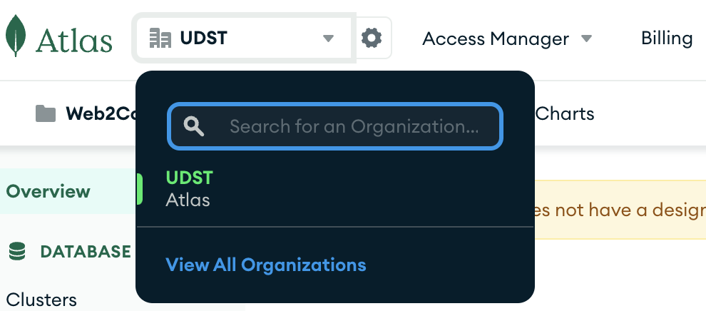
Organization
Organization
Project
Cluster
Database
Collection
Document
Could be used if you were a consultant working with multiple companies.
A single organization called UDST would be fine for this course.

Slide 4
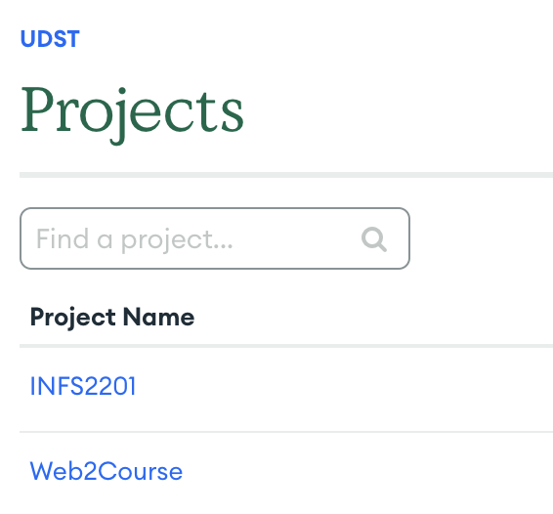
Project
Organization
Project
Cluster
Database
Collection
Document
Could be used to represent a project within an organization.
Recommend creating one project for each course that you are using Atlas.

Slide 5
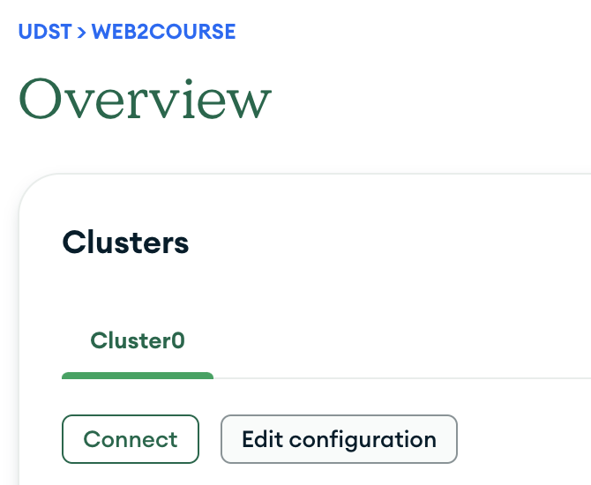
Cluster
Organization
Project
Cluster
Database
Collection
Document
A cluster is a server hosting the databases.
You need at least one cluster.
The M0 (free) cluster is fine for the course
The initial connection from your application to the database is a bit slow but once connected the performance is acceptable.

Slide 6
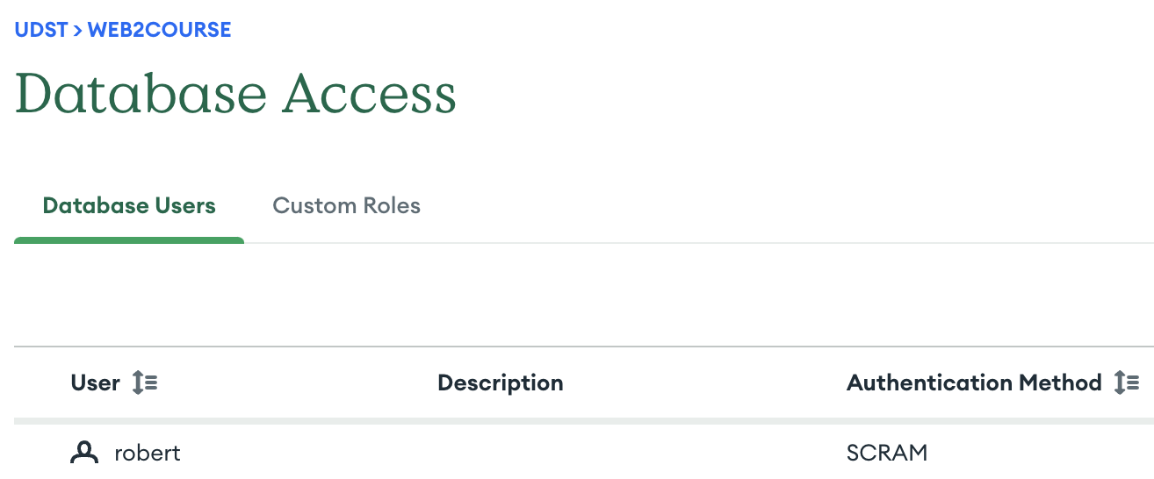
Database Access
Your Atlas account is NOT USED to connect to your Atlas Databases!
Database users are separate.
Do not use your Atlas password or account for a database!
Create a database user and use a separate password
It is better to keep special characters out of the password, they will cause you trouble when connecting.

Slide 7
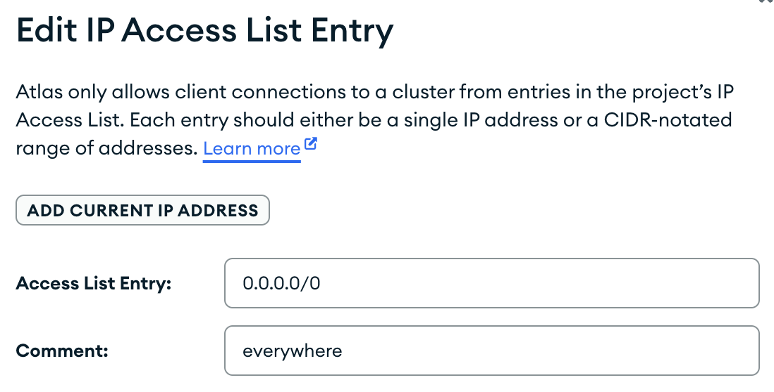
Network Access
Atlas configures databases to be accessible by the IP address where you initially created the database.
If you do not change this, the instructor will not be able to run your applications for your labs and assignments and you will receive a very low score which will not be adjusted.
Modify the network access to be 0.0.0.0/0.
This this from off campus or let the instructor test is while grading…. your choice.

Slide 8
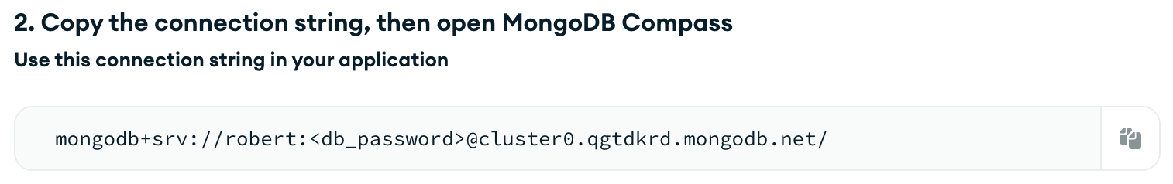
Compass
Although it is possible to manage databases and collections from Atlas, use Compass instead.
When replacing the password make sure to remove the < and > symbols!

